Slide 1
IBM University Engagement Project Submission
“Exploring the Power of Agentic AI with IBM Granite and LangFlow”

Slide 2

Project Tile – [Smart Business Idea Generator Agent ]
Domain of Project – [Business… ]
Student Name | Recent Passport Photo | Email ID | Mobile number [WhatsApp]
Om Yadav |  | om003y@gmail.com | 9881502848

Slide 3
Problem Statement –
Problem Statement : Business Idea Generator Agent
The Challenge
In the digital era, innovation is crucial, but individuals, students, researchers, and organizations often struggle with idea generation. Brainstorming sessions are unstructured, inspiration is scattered across articles, videos, and social media, and existing tools focus on text-only prompts without context-awareness. The challenge is not just to suggest random ideas but to synthesize creativity, context, and relevance into intelligent, actionable ideas for diverse domains such as startups, research, content creation, or product development
The Objective
Build an agentic AI Smart Idea Generator that empowers users with contextual, innovative, and multimodal ideation. The solution should:
Fuse Knowledge Sources: Pull insights from articles, research papers, trend analysis, and social platforms to generate contextual and current ideas.
Enable Multimodal Brainstorming: Accept inputs like text prompts, images (e.g., product sketches), or voice notes and refine them into structured, creative suggestions.
Create a Predictive & Agentic Layer: Identify trending domains (e.g., AI in healthcare, sustainable energy), forecast idea relevance, and recommend high-impact directions.
Visualize Idea Maps: Provide an interactive dashboard that organizes ideas into categories, impact scores, and feasibility maps, helping users explore and refine concepts quickly.

Slide 4
Proposed Solution -
Proposed Solution: AI-Powered Business Idea Generator
The Smart Business Idea Generator is a web-based application that helps aspiring entrepreneurs, students, and startup enthusiasts discover innovative business ideas based on their interests. The system uses a predefined database of business ideas categorized into different industries such as Technology, Food, Education, Health, Finance, Fashion, and Environment. Users simply select a category and the application generates a unique business idea along with useful information such as investment requirements, difficulty level, and business potential.
The application is developed using HTML, CSS, and JavaScript, making it lightweight, responsive, and easy to use without requiring any backend server or database.
Working of the System
1. The user opens the website.
2. The homepage displays different business categories.
3. The user selects a preferred category.
4. The user clicks the Generate Idea button.
5. JavaScript randomly selects a business idea from the chosen category.
6. The website displays:
- Business Name
- Description
- Estimated Investment
- Difficulty Level
- Business Potential Rating
7. The user can generate another idea anytime.

Slide 5
Technology Used
Langflow platform -For designing and orchestrating multi-agent workflows visually
IBM Granite model - for eg – ibm-granite-3-2-8b – For natural language understanding, reasoning, and personalization
IBM Cloud – It provides the infrastructure to build, deploy, and scale the Nutrition Agent efficiently. IBM Cloud enables a reliable, secure, and scalable environment for deploying the Nutrition Agent.
RAG– RAG to fetch real data first, then generate intelligent answers, making the Nutrition Agent more trustworthy and effective.
IBM Watsonx.ai - For model deployment, embeddings, and AI governance
Vector Database (FAISS/Chroma) – For RAG-based nutritional data retrieval

Slide 6
Langflow component Used -
Langflow Components Used
Chat Input – Receives the user's business requirements.
Prompt – Defines the AI's role and instructions.
LLM (OpenAI/Groq/Gemini/Ollama) – Generates personalized business ideas.
Agent – Analyzes user input and makes intelligent decisions.
Memory – Remembers previous conversation context.
Output (Chat Output) – Displays the generated business ideas and recommendations.

Slide 7
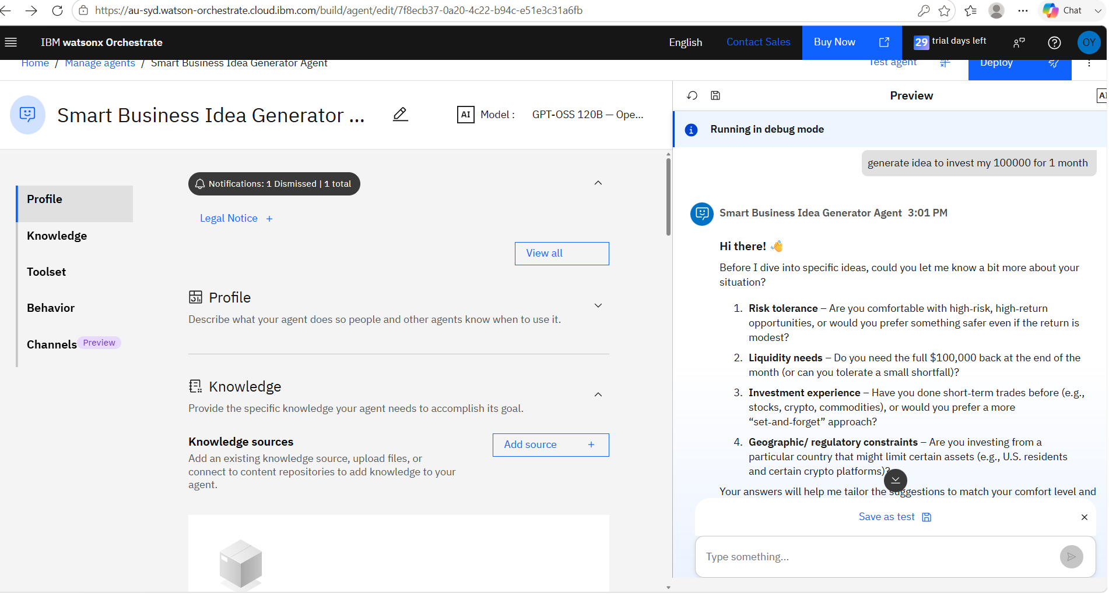
Langflow workflow -

Slide 8

Role of Agentic AI in the solution
Role of the Agentic AI in Smart Business Idea Generator Agent
The Agentic AI acts as an intelligent business advisor that understands the user's needs, analyzes their inputs, and recommends personalized business ideas with practical guidance. It helps users make informed decisions and choose the most suitable business opportunity.

Slide 9
Novelty and Uniqueness
Novelty and Uniqueness – Smart Business Idea Generator Agent
Generates personalized business ideas instead of generic suggestions.
Considers the user's skills, interests, budget, and location.
Analyzes current market trends to recommend relevant opportunities.
Provides investment, profit, risks, and growth potential for each idea.
Offers a step-by-step business launch plan.
Recommends the best business idea based on the user's profile.
Saves time by delivering data-driven and practical recommendations in one place.

Slide 10
Git Hub Link
Please create public github repository (Enable Add README button while creating repository) with format –
Please test and Paste the working Github URL – omyadav003/Smart-Business-Idea: The Smart Business Idea Generator Agent is an AI-powered assistant that helps users discover profitable and practical business ideas based on their interests, skills, budget, location, and current market trends.
Make sure you have Uploaded following three files into your github repository 1) app.json file , 2) yourproblemstatement.pdf file 3) your projectpresntation.pptx file 4)any other files
·
·
·

Slide 11
Future Scope
1. AI-Based Business Plan Generation
The system can automatically generate complete business plans, including executive summaries, market analysis, financial projections, marketing strategies, and operational plans based on the selected business idea.
2. Real-Time Market Trend Analysis
By integrating live market data, news, and industry reports, the application can recommend business ideas based on current market demand, emerging technologies, and consumer trends.
3. Financial Feasibility Analysis
Future versions can estimate startup costs, expected revenue, profit margins, break-even points, and return on investment (ROI), helping users evaluate the financial viability of their business ideas.
4. Competitor Analysis
The system can analyze existing competitors in the selected business domain and provide insights into their strengths, weaknesses, pricing strategies, and market positioning
·
·
·

Slide 12
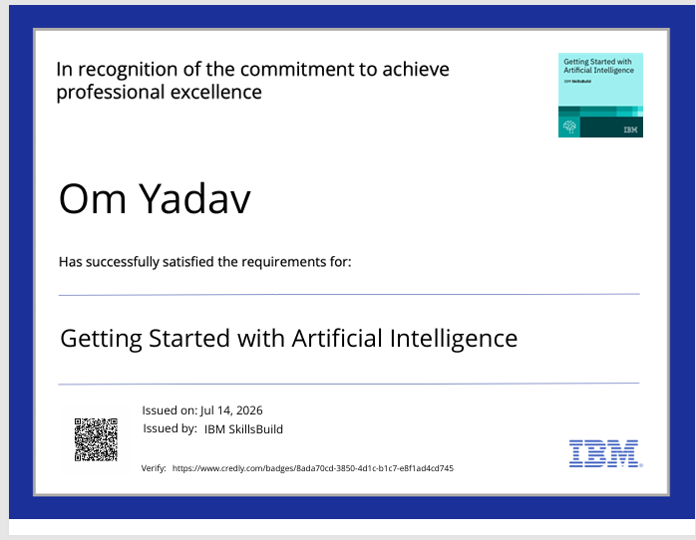
Certificates Earned:
Please add your credly certificate

Slide 13
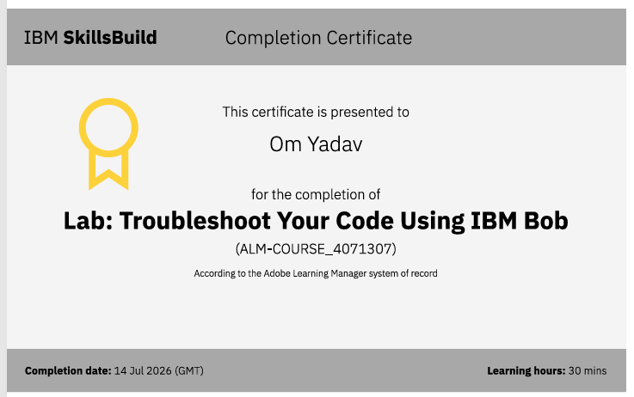
Certificates Earned:​
Add your IBM BOB Certificate

Slide 14


